Slide 1
Discriminant Function Analysis for FT-IR Data in MATLAB
Felicity Currie
MBPG, LSTM

Slide 2
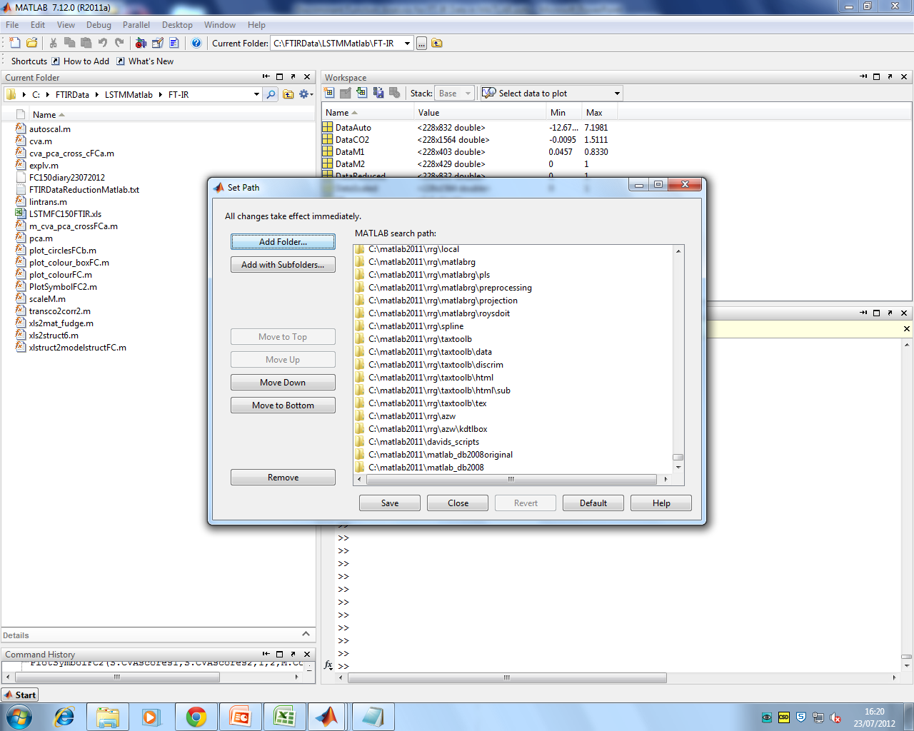
Copy the files in the folder to a folder on your computer. You can either carry out MATLAB work in this new folder or add the folder and subfolders to the path MATLAB uses using
File-Set Path

Slide 3
This presentation shows the use of a series of MATLAB methods for the analysis of FT-IR data to perform a principal components-discriminant function analysis (PC-DFA). The terms discriminant function analysis and canonical variant analysis (CVA) are used interchangeably here, the difference being the scaling in the method.

Slide 4
The FT-IR data and Metadata associated with the experiment is held in the Excel workbook LSTMFC150FTIR.xls in the following sheets:
RawData - raw FT-IR data
FTIR - metadata includes sample index, sample number, drug, concentration, concentration replicates and masks for the matlab methods
Index - the indices for samples exposed to individual drugs
ut832 – lists 832 wavenumber bins used in the analysis and 834 wavenumber bins used in plots
Data preprocessing necessary for FT-IR data includes
removal of absorbances due to carbon dioxide
autoscaling of individual spectra between 0 and 1
removal of spectral regions containing no data of biological interest
autoscaling of variables to mean absolute deviation

Slide 5
Pre processed data is then taken into a MATLAB structure for PC and CVA analysis
PC-CVA scores plots show the discrimination between different classes (in this instance different drug exposures)
Overlaid loadings plots show the wavenumbers that contribute to the discrimination between classes.

Slide 6
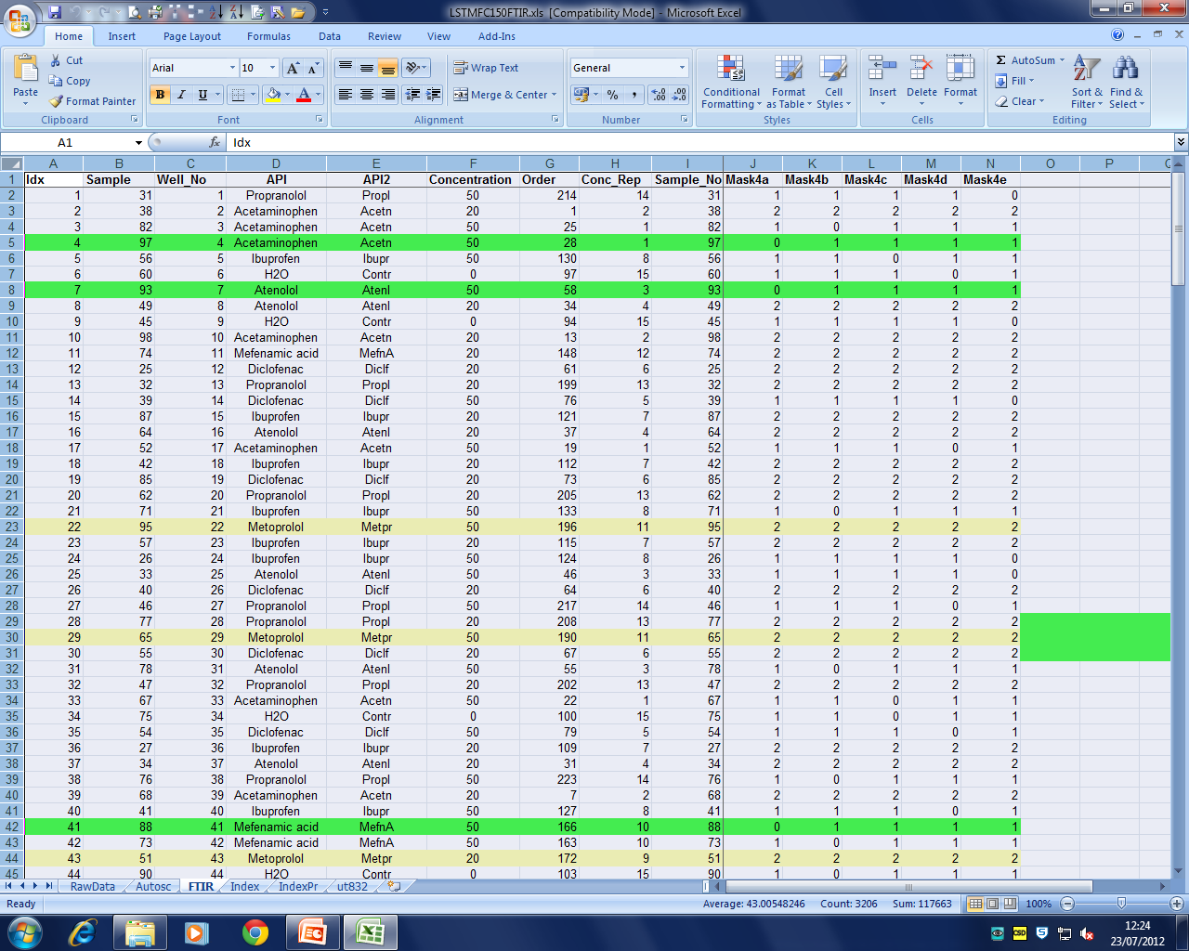
Metadata in LSTMFC150FTIR.xls
Idx is the index or run order of the samples in the data matrix
API is the drug name
Conc_Rep is the concentration replicate and defines the sample classes, and colours used in the plots
Mask defines which samples are used in the analysis for training (1) or validation (0), or are omitted from the analysis (2)
Don’t worry about the other columns

Slide 7
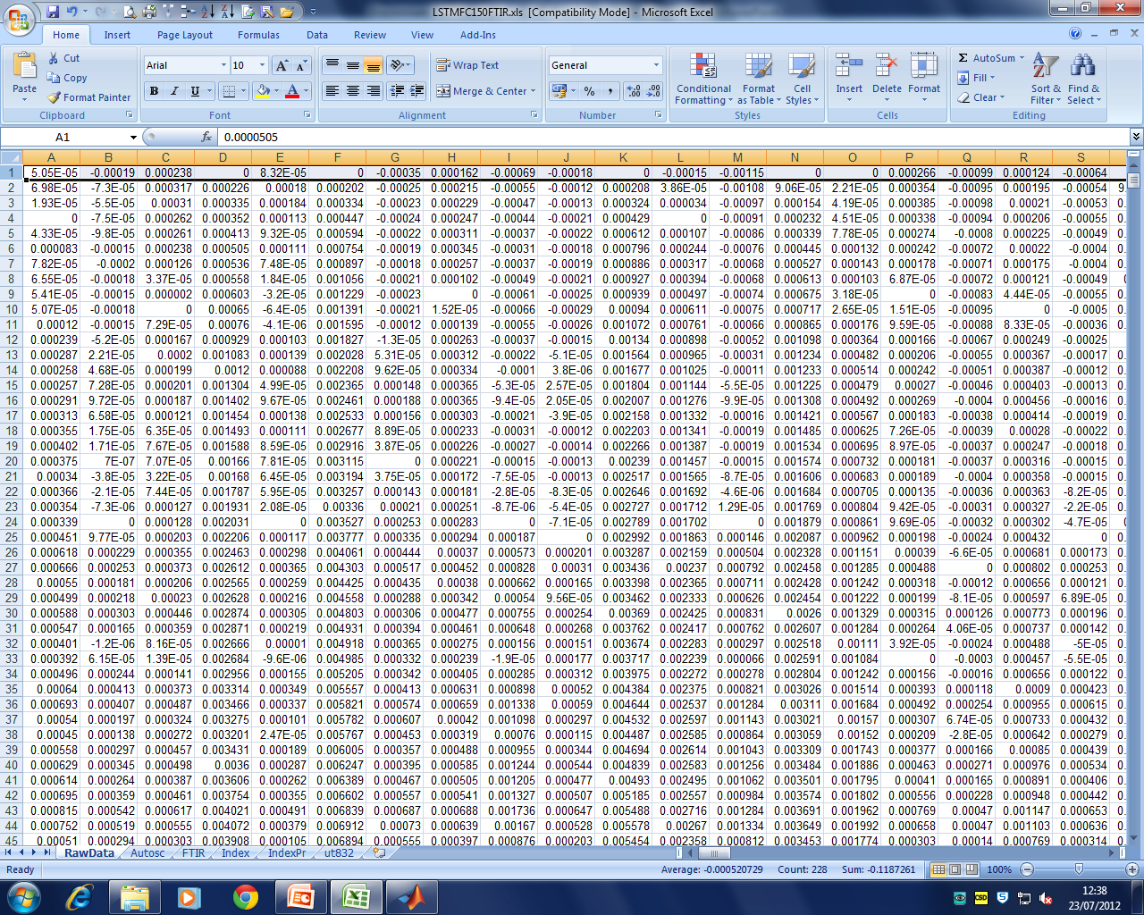
The raw FT-IR data is held in Excel as 1764 wavenumbers in rows x 228 samples in columns
Matlab methods work on the transposed matrix i.e. samples in rows x wavenumbers in columns

Slide 8
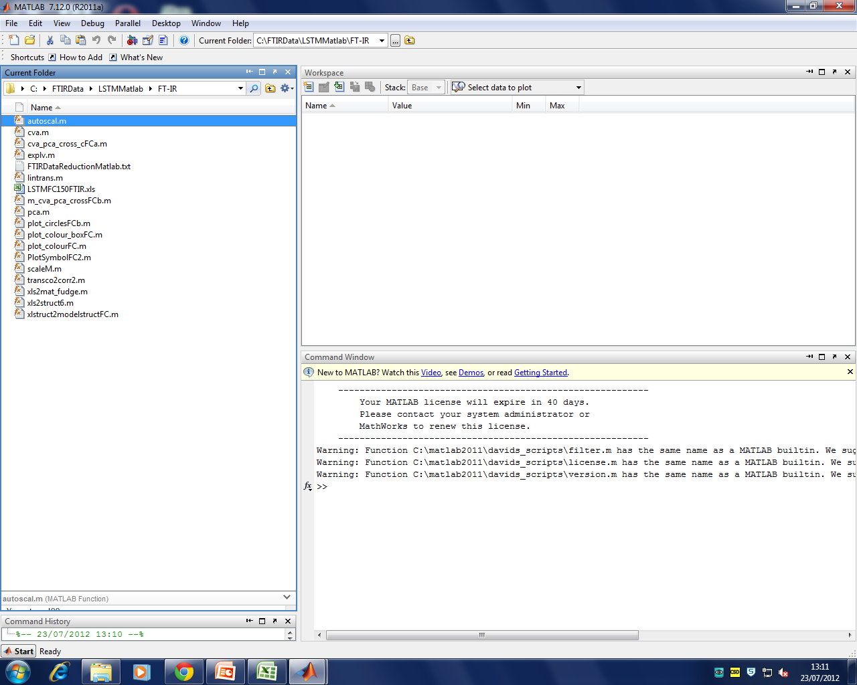
Open MATLAB and change the Current Folder to the folder where the MATLAB files and data are stored

Slide 9
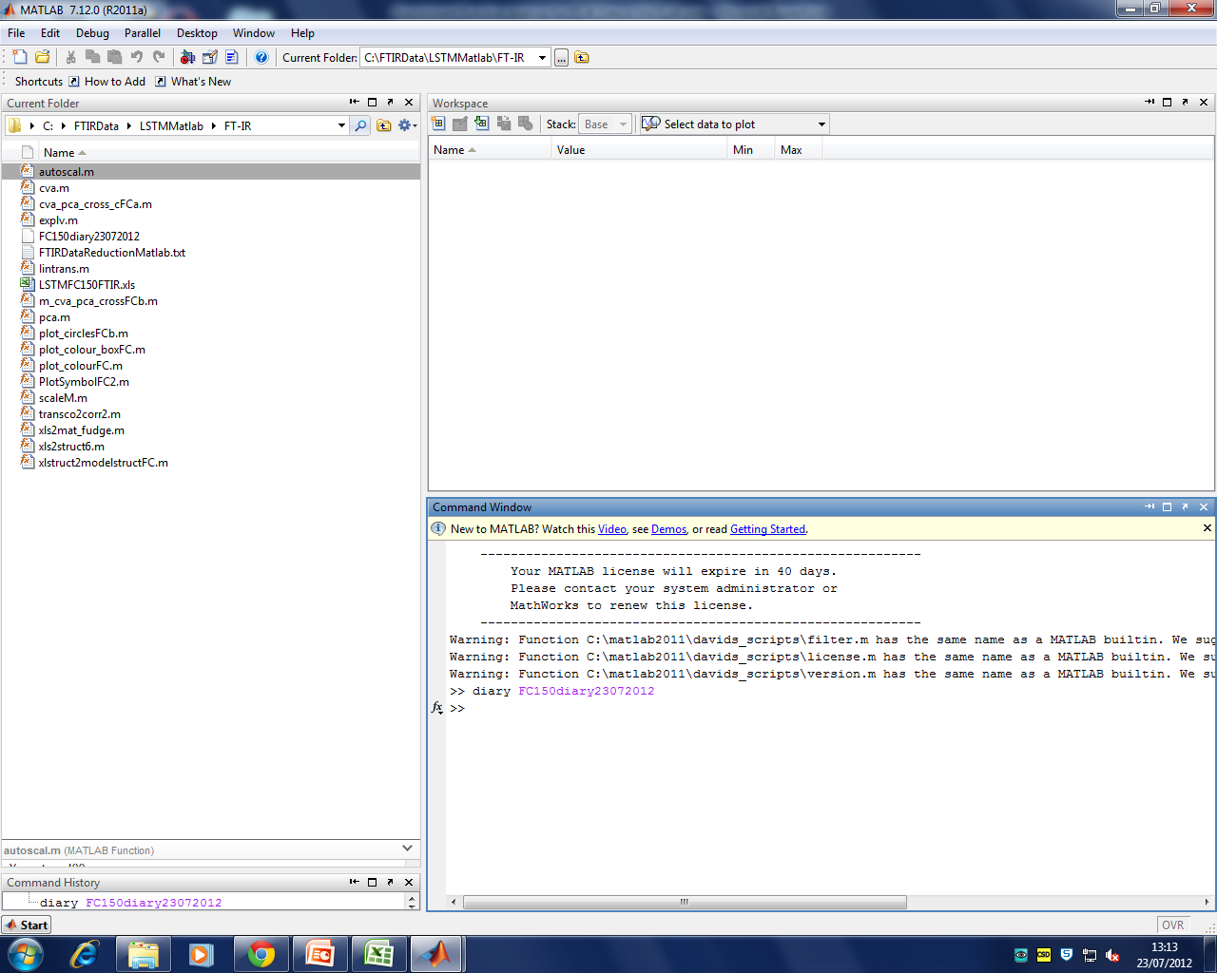
MATLAB commands are entered here
Creating a diary will create a text file of all the commands you use in the session

Slide 10
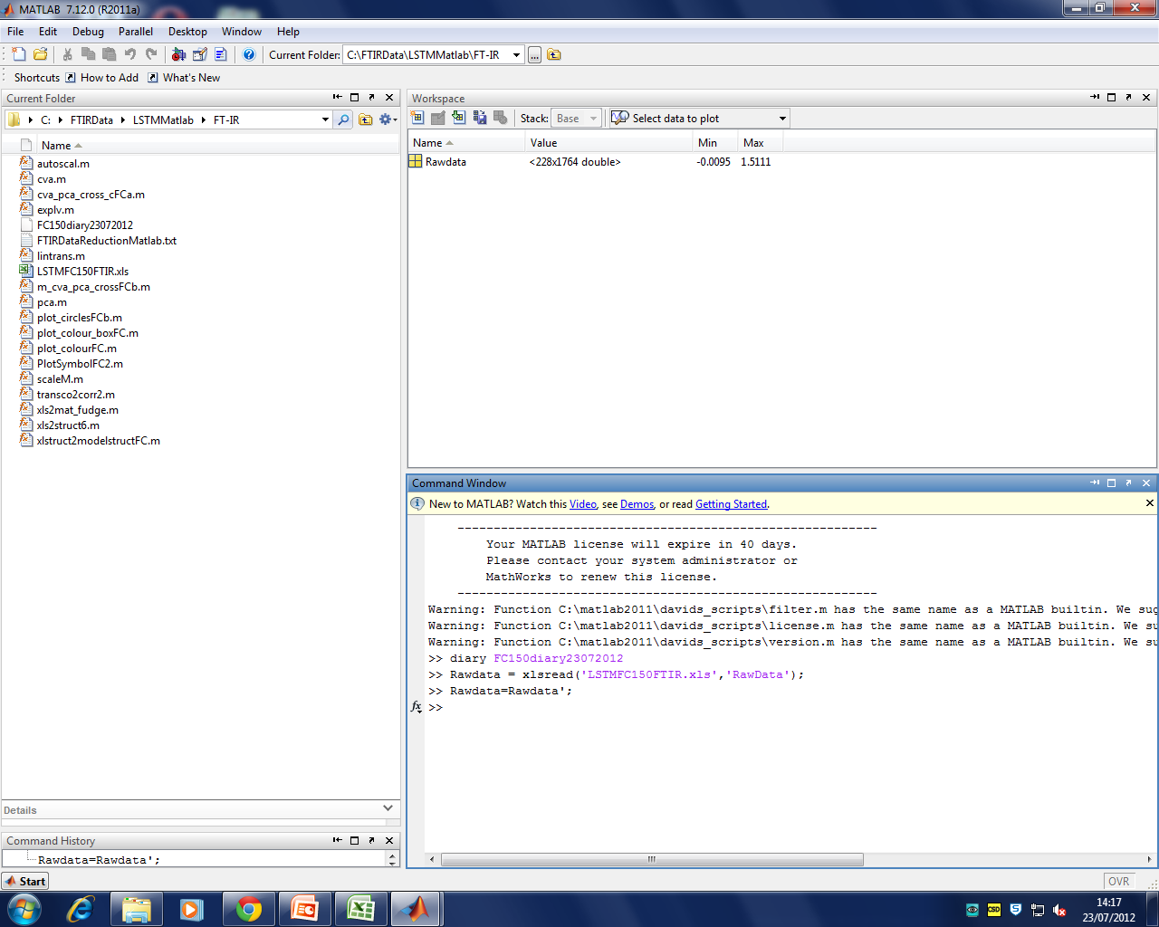
Read in the raw data from Excel and transpose it
The new data matrix is 228 samples x 1764 wavenumbers and appears here

Slide 11
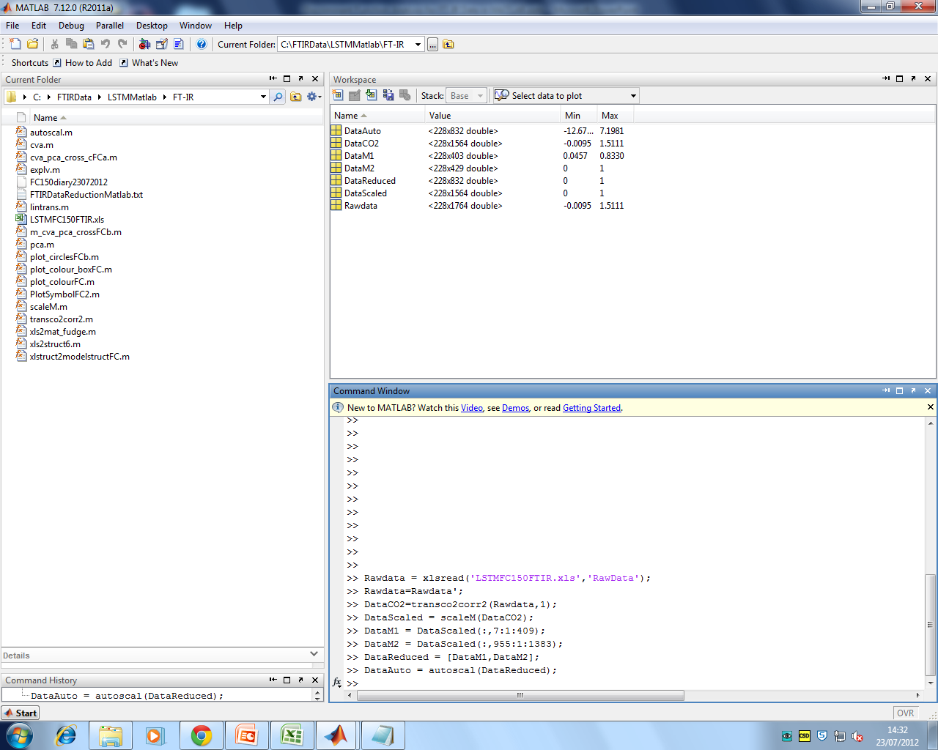
Data preprocessing steps
removal of absorbances due to carbon dioxide
autoscaling of individual spectra between 0 and 1
removal of spectral regions containing no data of biological interest
autoscaling of variables to mean absolute deviation

Slide 12
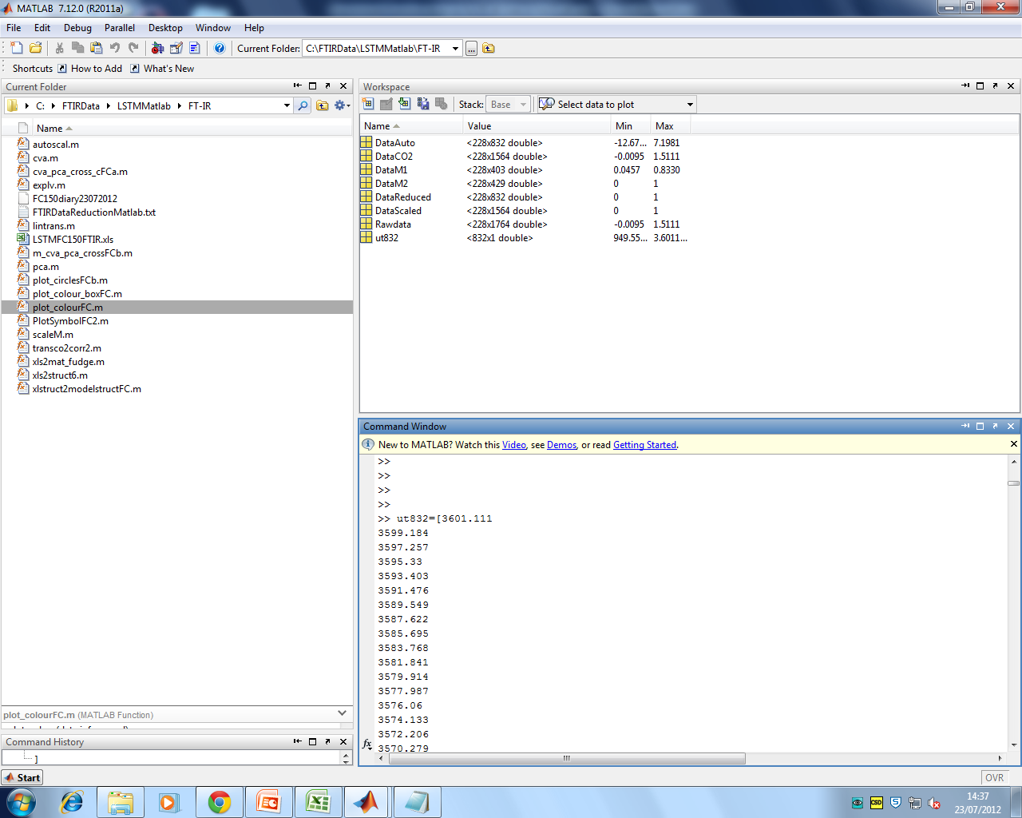
Paste in the 832 wavenumbers with the name
ut832

Slide 13
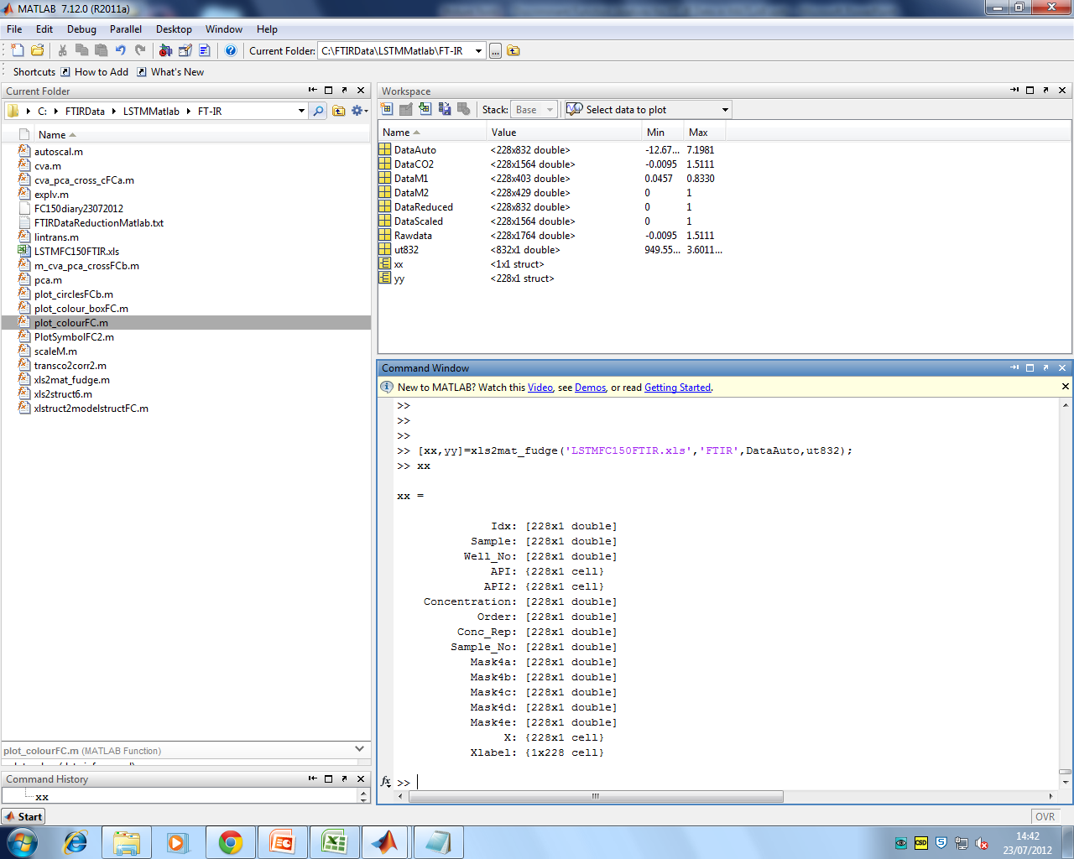
Create a data structure to hold the preprocessed data and the metadata from Excel

Slide 14
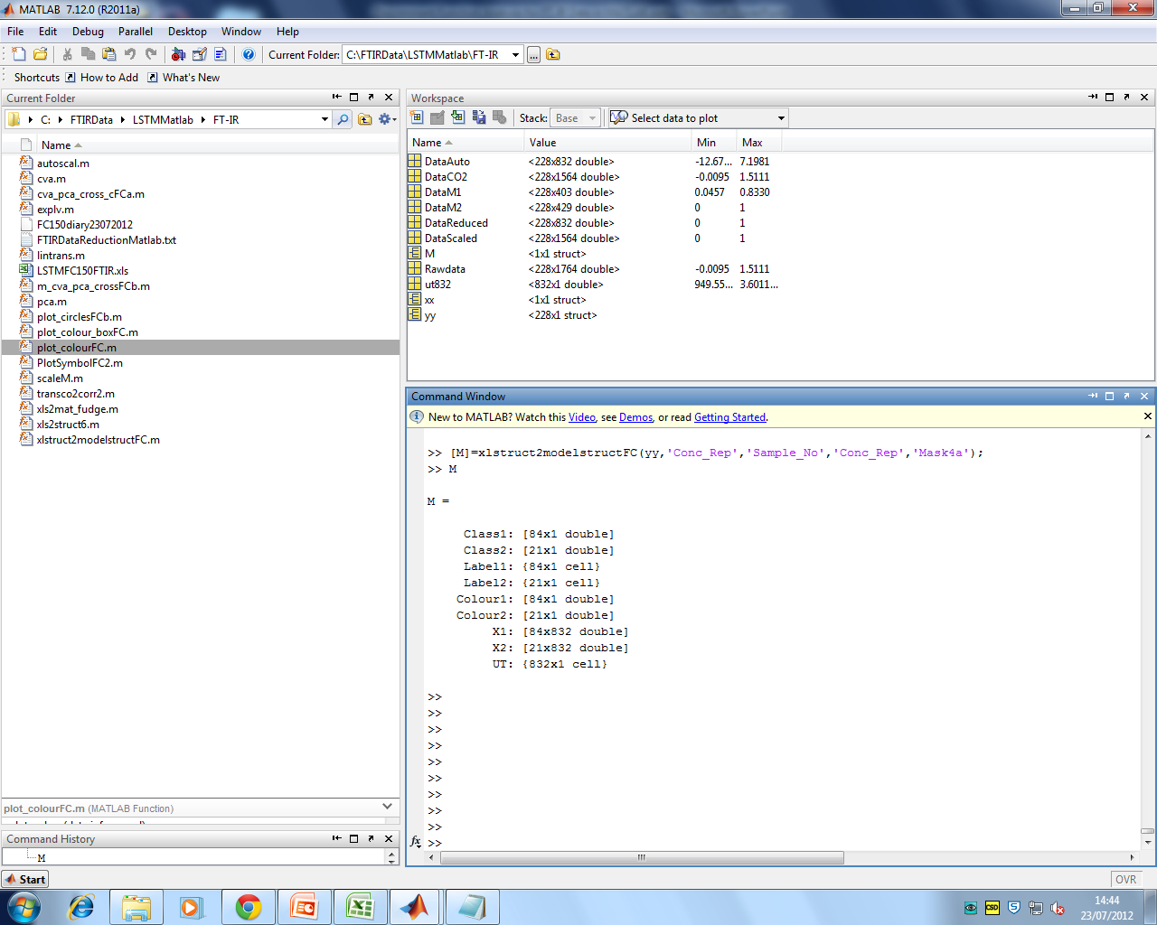
Create a data structure, M, for the analysis
‘Conc_Rep’ is used here to define the sample classes and also the colour in the plots
‘Sample_No’ is used here for the marker on the plots
‘Mask4a’ defines the samples used for training and validation in the analysis
The analysis should be repeated with n-fold iterations of samples for training and validation e.g Masks 4a-4d, or iterations of 10% samples selected at random for the validation

Slide 15
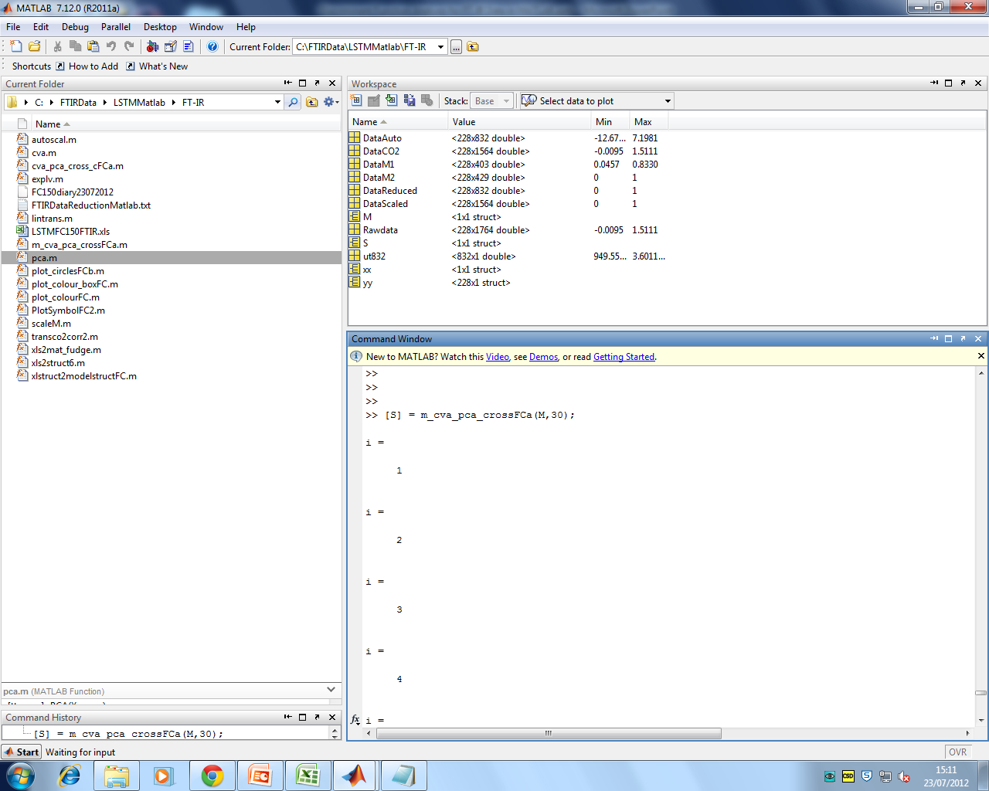
Run the PC-CVA analysis o the data structure M
The first part creates a specified number of PCs (here 30)
The second part asks for the number of PCs to be used in the CV analysis (here 26)

Slide 16
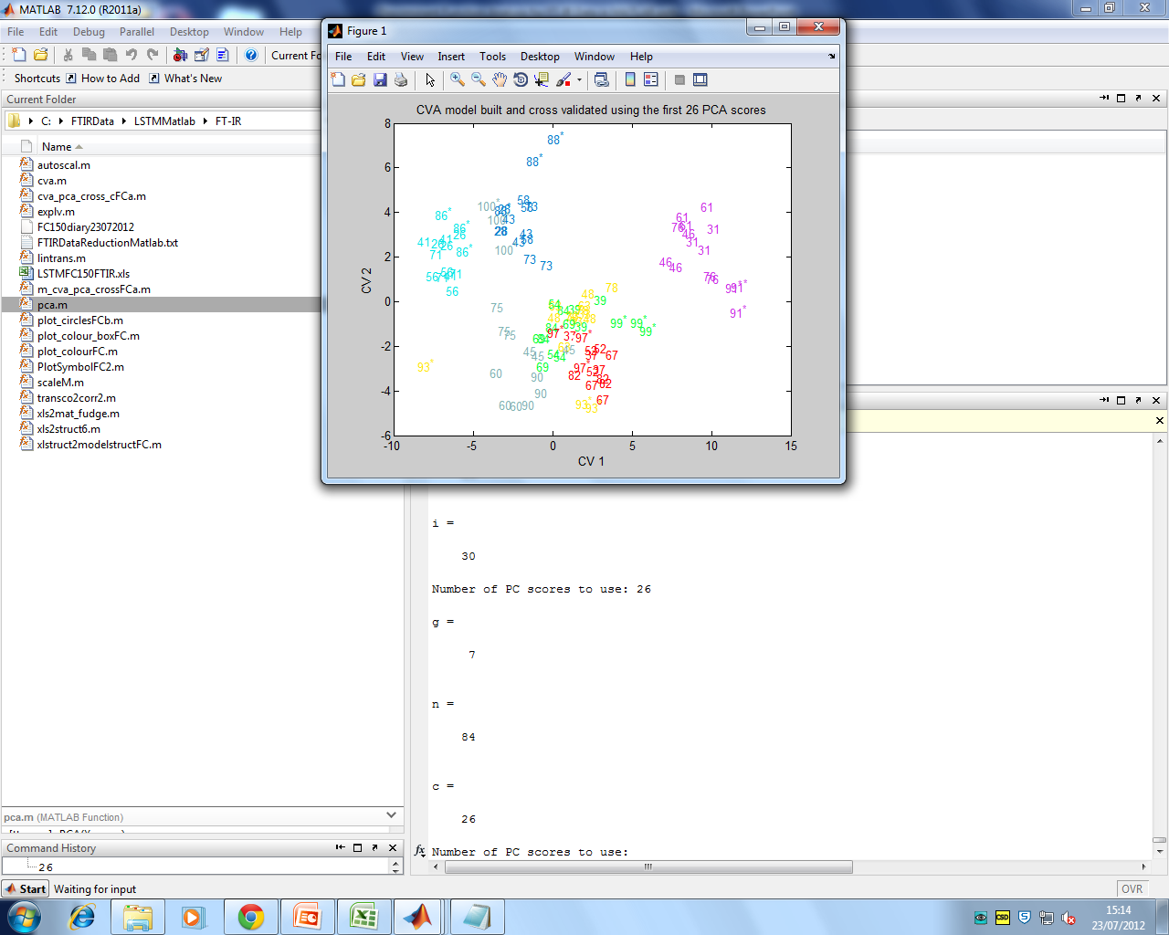
The CVA scores plot is shown
sample numbers are plotted
*denotes the validation samples defined in Mask4a
You should change the number of PCs used in the analysis and study the plots for the best separation between groups where the validation samples fall within the bounds of the training set

Slide 17
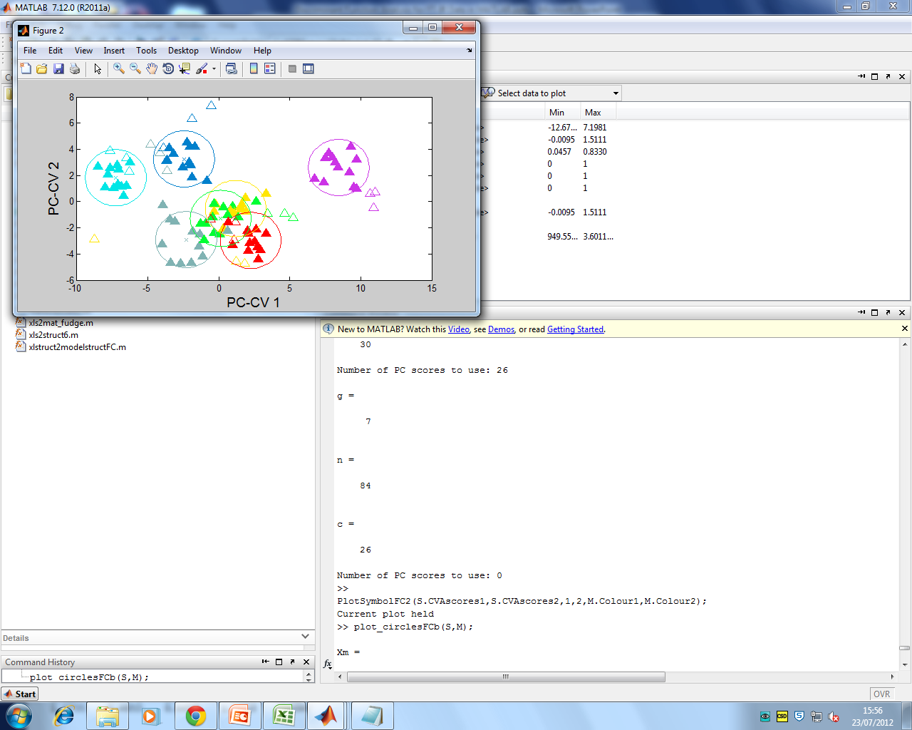
Once the optimum number of PCs to be used has been decided on enter zero to exit the PC-CVA method.
The plot can be redrawn with symbols rather than sample numbers and the bounds defined by the χ² distribution for the scores for the training data
Validation data is shown in unfilled symbols and should fall within the bounds for the training data (filled symbols)

Slide 18
Matlab commands to run PC-DFA analysis on FT-IR data
>> Rawdata = xlsread('LSTMFC150FTIR.xls','RawData');
>> Rawdata=Rawdata';
>> % paste in 832 wavenumbers
>> DataCO2=transco2corr2(Rawdata,1);
>> DataScaled = scaleM(DataCO2);
>> DataM1 = DataScaled(:,7:1:409);
>> DataM2 = DataScaled(:,955:1:1383);
>> DataReduced = [DataM1,DataM2];
>> DataAuto = autoscal(DataReduced);
>> [xx,yy]=xls2mat_fudge('LSTMFC150FTIR.xls','FTIR',DataAuto,ut832);
>> [M]=xlstruct2modelstructFC(yy,'Conc_Rep','Sample_No','Conc_Rep','Mask4a');
>> [S] = m_cva_pca_crossFCa(M,30);
Number of PC scores to use: 26
Number of PC scores to use: 0
>> PlotSymbolFC2(S.CVAscores1,S.CVAscores2,1,2,M.Colour1,M.Colour2);
Current plot held
>> plot_circlesFCb(S,M);

Slide 19
Matlab commands to run PC-DFA analysis on FT-IR data:
overlaid plots of spectra and significant loadings
CellsPropr=DataRNDb(71,:);
CellsProprM1=CellsPropr(:,1:1:403);
CellsProprM2=CellsPropr(:,404:1:832);
CellsPropr834=[CellsProprM1 0 0 CellsProprM2];
WavenumberID=(1:1:834);
WavenumberID=WavenumberID'
ut834str=num2str(ut834);
CVLoad=S.T_loadings(1:832,1);
CVLoad=CVLoad';
CVLoad1=CVLoad(:,1:1:403);
CVLoad2=CVLoad(:,404:1:832);
CVLoad834=[CVLoad1 0 0 CVLoad2];
CVLoad834=CVLoad834';
plot(ut834,CellsPropr834,'g');
hold
Current plot held
plot(ut834,Propranolol','r');
[out,outabs,outsort,P,Q,R] = varplotgteq2SDFTIRMay09(ut834,CVLoad834,WavenumberID,ut834str);
level =
0.9191
Having seen the first plot you may wish to replot and scale the loadings appropriately e.g.
[out,outabs,outsort,P,Q,R] = varplotgteq2SDFTIRMay09(ut834,CVLoad834/5,WavenumberID,ut834str);
Finally use the Matlab edit figure commands to reverse the x-axis and adjust the y-axis

Slide 20
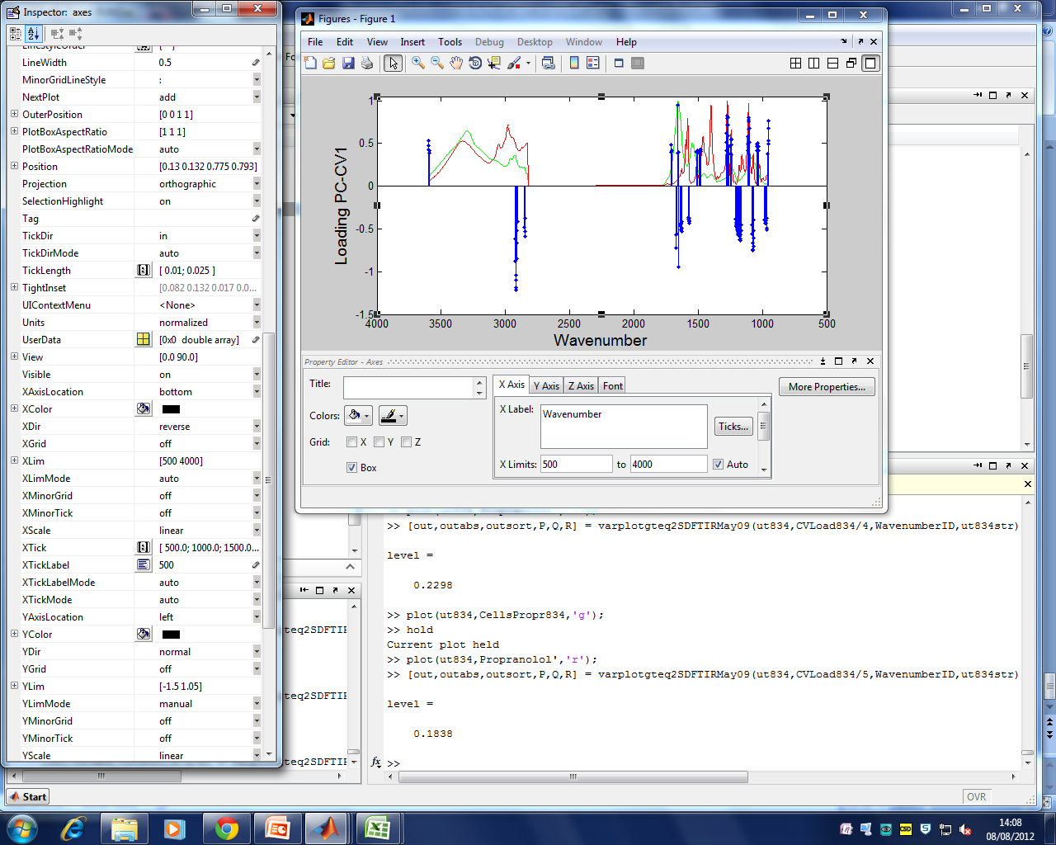
overlaying plots of spectra and significant loadings
Overlaid spectra of cells in green and propranolol in red
Having seen the first plot you may wish to replot and scale the loadings appropriately
Finally use the Matlab edit figure commands to reverse the x-axis and adjust the y-axis

